Slide 1


Predicting binding free energies on a large scale
The Binding Energy Distribution Analysis Method (BEDAM)
Results from SAMPL4 and work with the HIVE Center at Scripps
Markov State Models of Hamiltonian Replica Exchange
Notes:
Introduction for ACS Symposium on Generalized Ensemble methods, San Francisco, March 2010
I would like to thank the organizers for inviting me to speak.
I want to talk today about work in our lab over the past few years which combines Replica Exchange with network models for exploring energy landscapes for folding and binding.
I will start by saying a few words about developments with our implicit solvent model AGBNP and then discuss how we can use REMD with network models to analyze the efficiency of replica exchange and explore folding pathways and their fluxes.
I have worked closely on these projects with the three people listed here. Emillio Gallichio my collaborator and friend is the driving force behind our implicit solvent model AGBNP. He is also doing clever things with Hamiltonian Replica Exchange for binding free energy simulations. He will be talking about that on Thursday in another symposium. Mike Andrec is a research scientist in the group and Weihua Zheng is a graduate student just finishing up.
------------------------------------------------------
Introduction for Previous talks
The metaphor of exploring protein landscapes plays a central role in modern computational biophysics. By landscape we mean a kind of topographical map that provides us with information about the important structural states of proteins and the paths by which they interconvert.
Much of our information about protein landscapes come from reduced models which have been extremely informative, but which also tens to provide generic information about how proteins might fold, rather than how a specific sequence does fold. The hope is that more detailed models that are fully atomic can provide us with information beyond what we can learn using reduced models. Although this is guaranteed to be the case.
I am going to talk about recent work in my lab using all atom models to study protein folding and binding by computer simulation.
The two key ingredients for carrying out these simulations are an effective potential that serves to define the topography of the landscape and a method for exploring the landscape. The computational requirements for exploring landscapes of all atom models are severe and a great deal of effort is going into the development of new and powerful sampling algorithms – one of the most promising of which is called Replica Exchange.
I am going to start by describing our all atom effective solvation potential and the sampling method we are using. The use of all atom models to simulate protein folding makes extreme demands on sampling methods. If we are going to realize the full power of all atom models, further advances in replica exchange and other sampling methods which make use of distributed computing are going to be needed. I want to return at the end of my talk to make observations about the relationship between physical kinetics and kinetics in the replica exchange ensemble.
We are using network models in two different ways: (1) to study protein folding pathways, and (2) to analyze the convergence characteristics of replica exchange simulations.
Then I will tell you a little about the free energy surfaces predicted by this effective potential.
Then I will describe the peptide folding simulations.
Most of the work I will talk about is focused on the GB1 peptide, a beta hairpin, which has been much studied both experimentally and by computer simulation.

Slide 2
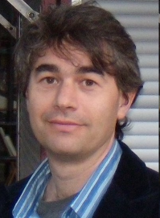

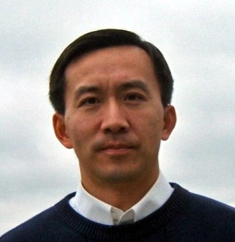



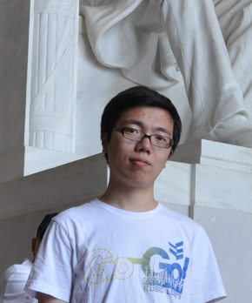


Acknowledgments
Emilio Gallicchio
Bin Zhang
Nan-jie Deng
Bill Flynn
Lauren Wickstrom
Wei Dai
Peng He
Mauro Lapelosa
Notes:
Same for receptor
Slide on restrain/release ala Mobley?

Slide 3
Binding Free Energy Models
[Gallicchio and Levy, Adv. Prot. Chem (2012)]
Relative Binding
Free Energies (FEP)
Double Decoupling
Method (DDM)
λ-dynamics
Potential of Mean Force/
Pathway Methods
A t o m i s t i c
Docking & Scoring
Implicit Solvation
Statistical mechanics theory
BEDAM
(Implicit solvation)
Exhaustive docking
Binding Energy Distribution Analysis Method
MM/PBSA
Mining Minima (M2)

Slide 4

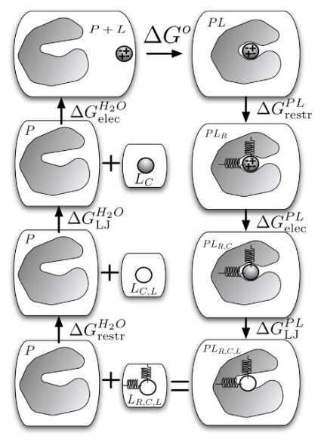
Binding Free Energy Methods
Statistical mechanics based, in principle account for:
Total binding free energy
Entropic costs
Ligand/receptor reorganization
Free Energy Perturbation (FEP/TI)
Double Decoupling (DDM)
Jorgensen, Kollman, McCammon (1980’s – present)
Jorgensen, Gilson, Roux, . . . (2000’s – to present)
:
Challenges:
Dissimilar ligand sets
Numerical instability
Dependence on starting conformations
Multiple bound poses
Slow convergence
Notes:
Binding free energy simulation methods come in different flavors. They share a firm foundation in statistical mechanics. They account for the total binding free energy, most notably the entropic costs for binding and the free energy costs for reorganizing the ligand and the receptor into their binding competent comformations. FEP methods raised great expectations in the CADD world when they first came out in the early 1980s and this was followed by disappointment and a sense that the methods were oversold. I think there are a number of reasons to believe the time is right to put time and effort into free energy methods again. FEP is a method to calculate the relative free energy difference between binding two ligands by carrying out a series of simulaitons in which ligand A is turned into B by an alchemical path. In double decoupling the absolute binding free energy of a ligand is computed as the difference beteen two simulaitons; in the first the ligand starts off fully interacting with the receptor and those interactions are slowly turned off, and in the second the ligand starts of fully interactions with the solution and those interactions are turned off. The challenges in getting these methods to work reliably involve these issues among others. We have taken another approach which I want to tell you about.

Slide 5
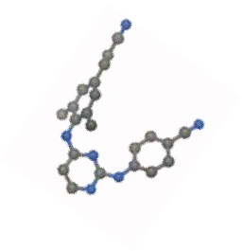
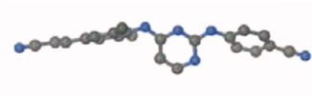
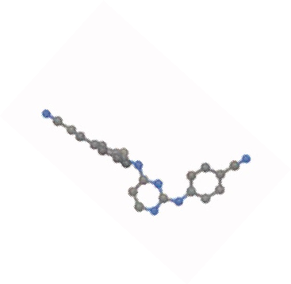
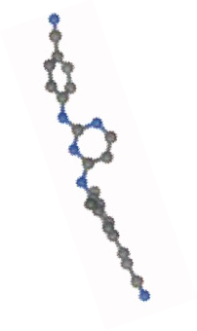
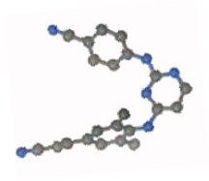
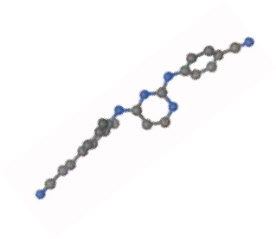
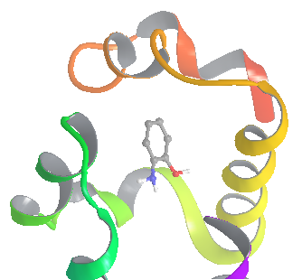
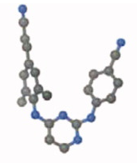
Free Energy of Binding = Reorganization + Interaction
BEDAM accounts for both effects of interaction and reorganization
Docking/scoring focus on ligand-receptor interaction
reorganization
interaction
Interatomic interactions
Notes:
Same for receptor
Slide on restrain/release ala Mobley?

Slide 6
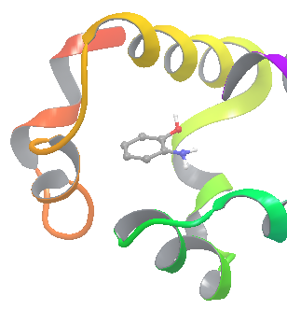
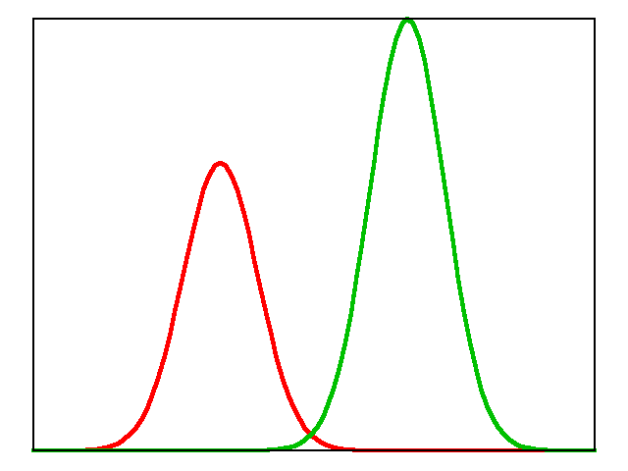
Statistical Thermodynamics Theory of Binding
[Gilson, McCammon et al., (1997)]
Binding “energy” of a fixed conformation of the complex.
W(): solvent PMF (implicit solvation model)
Ligand in binding site in absence of ligand-receptor interactions
Entropically favored

Slide 7
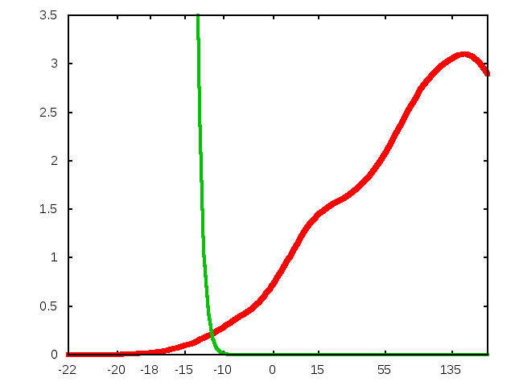
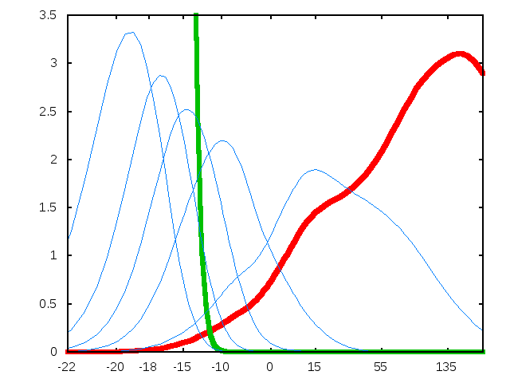
The Binding Energy Distribution Analysis Method (BEDAM)
P₀ (ΔE): encodes all enthalpic and entropic effects
Integration problem: region at favorable ΔE’s is seriously undersampled.
P₀(ΔE)
P₀(ΔE ) [kcal/mol⁻¹]
Solution:
Hamiltonian Replica Exchange +WHAM
Biasing potential = λ ΔE
Ideal for cluster computing.
Main contribution to integral
ΔE [kcal/mol]
Gallicchio & RML, JCTC 2011

Slide 8
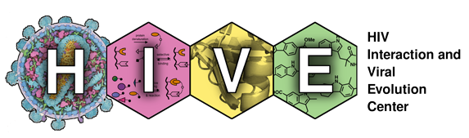
Large Scale Virtual Screening and Free Energy Evaluation of HIV Integrase Inhibitors
SAMPL4
Rutgers/Temple – E. Gallicchio, N. Deng, P. He, R. Levy
Scripps - A. Perryman, S. Forli, D. Santiago, A. Olson,

Slide 9
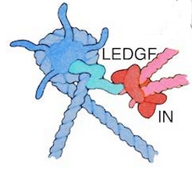
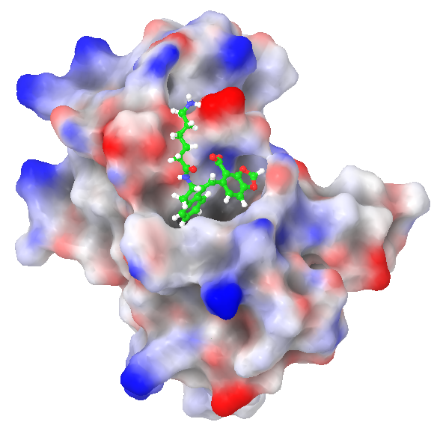
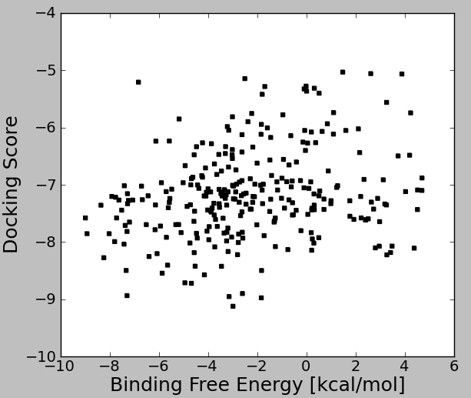
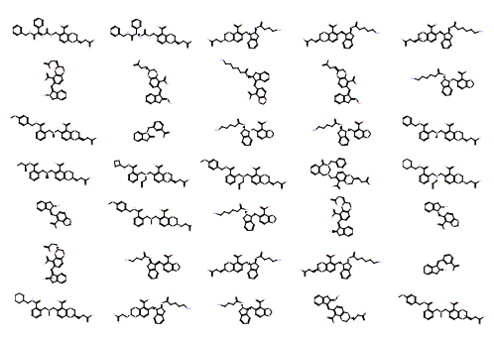
Large-Scale Screening by Binding Free Energy Calculations:
HIV-Integrase LEDGF Inhibitors
HIV-IN is responsible for the integration of viral genome into host genome.
The human LEDGF protein links HIV-IN to the chromosome
Development of LEDGF binding inhibitors could lead to novel HIV therapies
450 SAMPL4 Ligand Candidates
~350 scored with BEDAM
Docking + BEDAM Screening
IN/LEDGF Binding Site
-5
. . . . .
. . . . .
-5
SAMPL4 blind challenge: computational prediction of undisclosed experimental screens.
Docking provides little screening discrimination: “everything binds”! (but useful for prioritizing)
Much more selectivity from absolute binding free energies
BEDAM predictions ranked first among 23 computational groups in SAMPL4,
2.5 x fold enrichment factor in top 10% of focused library, but many incorrect predictions

Slide 10
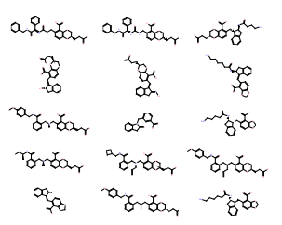
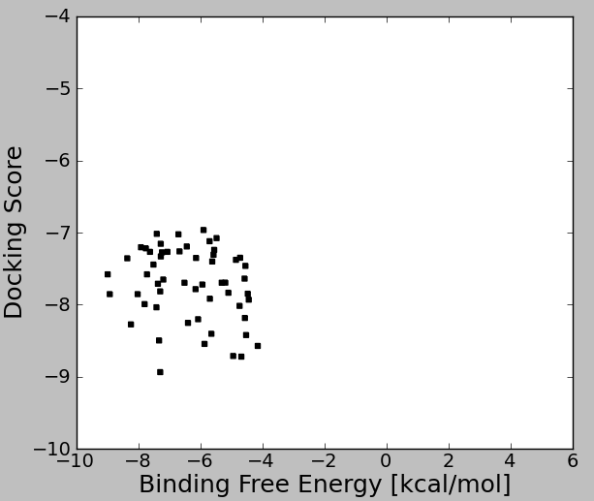
Practical Aspects of Screening by Binding
Free Energy Calculations (SAMPL4)
Automated setup and as much as possible unsupervised calculation process is key to handling large datasets.
Ligand Database (310)
Expanded Database (450)
Docked Complexes (450)
Crystal Structures Analysis +
Ensemble Docking
Protonation
Tautomerization
expansion
LigPrep/Epik
(minutes)
AutoDock/Vina
(hours/days)
BEDAM Setup
T-RE Conformational Analysis
(days)
Filtering/Prioritization
(days)
Binding Free Energy
Predictions (300)
Consensus
Predictions (68)
Prepped Complexes (300)
BEDAM parallel H-RE Calculations
IMPACT/OPLS/AGBNP2
(weeks; 1.2M CPU hours on XSEDE)
Emilio Gallicchio, Nanjie Deng, Peng He, RML (Rutgers)
Alex Perryman, Stefano Forli, Daniel Santiago, Art Olson (Scripps)

Slide 11
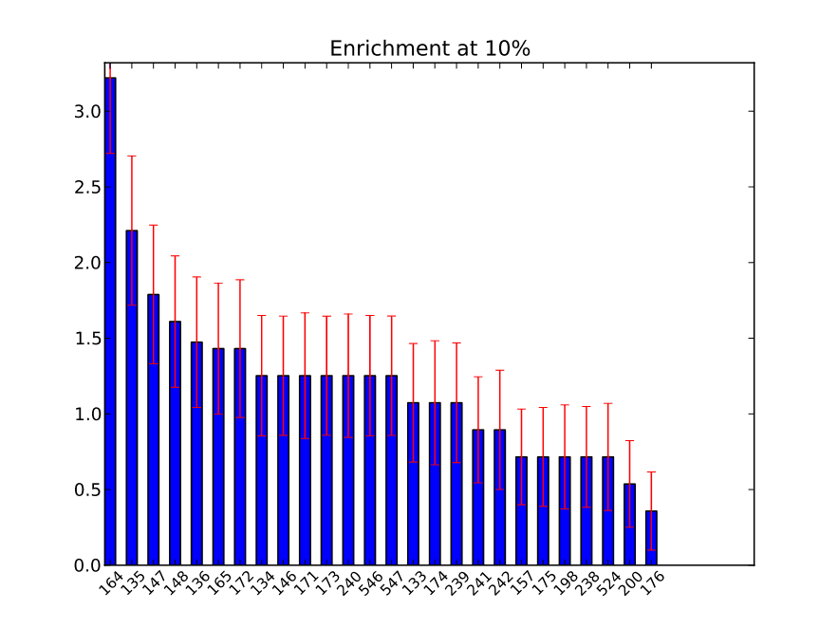
Screening Enrichment Performance
In-cerebro effort by Voet et al.
(HIV-IN experts)
BEDAM: best among computational groups
SAMPL4 Submissions

Slide 12
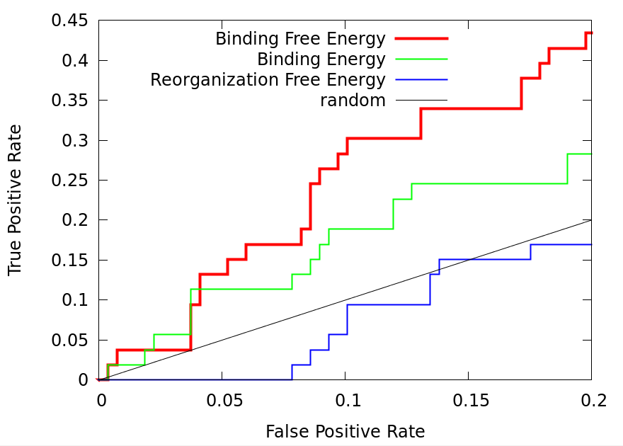
Importance of Including both Interaction and Reorganization
(positive = confirmed LEDGF binder)
Binding free energy scores significantly better than binding energy scores.
Only partial “enthalpy/entropy” compensation:
Gallicchio & Levy J Comp. Aid. Mol. Des. (2012).
Wickstrom, He, Gallicchio, Levy, JCTC (2013).

Slide 13
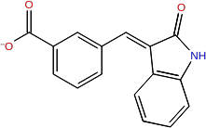
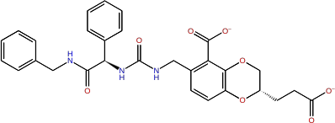
Importance of Accounting for Both Reorganization and Interaction
AVX17285_0, Binder:
AVX17734_1, Nonbinder:

Slide 14
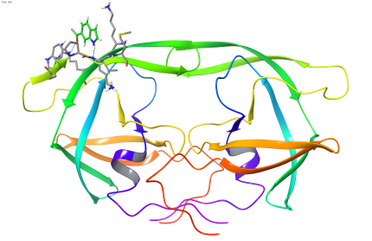
Combining Docking and Free Energy Methods to Reduce False Positives: Fragment Screening Against the HIV PR Flap Site
Located on top of the flaps, ligand binding could stabilize the closed conformation of the flaps.
The majority of the top docked ligands from a docking screening of 2499 compounds library are false positives.
A set of 23 docked ligands were chosen to evaluate the utility of BEDAM free energy based screening.
Perryman, A. L. et al. Chem. Biol. Drug Des. (2010).
Input ligands
Docked complex
3 binders
7 likely binders
13 false positives
BEDAM
AutoDock
BEDAM identified 85 % of the false positives, and recovered all three binders
See Nanjie Deng’s Poster

Slide 15
_{Conclusions}
BEDAM: The Binding Energy Distribution Analysis Method is a method to predict protein-ligand binding affinities from probability distributions of binding energies at many λ using parallel Hamiltonian Replica Exchange with implicit solvent
BEDAM can be used to estimate the binding affinities of hundreds of ligands to a receptor, it occupies a niche between docking and FEP/DDM in explicit solvent
In SAMPL4 where we placed first among the computational methods, we predicted the binding free energies of ~350 ligands, it is useful as a tool to be used in conjunction with docking to construct focused ligand libraries
Converging binding free energy simulations is still challenging, even in implicit solvent
Gallicchio, Levy; “Advances in all atom sampling methods for modeling protein-ligand binding affinities”. Curr. Op. Struct, Biol. 21, 161-166 (2011)
E. Gallicchio • N.Deng • P. He • L. Wickstrom • A. Perryman • D. Santiago • S. Forli • A. Olson • R. Levy “Virtual screening of integrase inhibitors by large scale binding free energy calculations: the SAMPL4 challenge” J. Comput Aided Mol Design, 2014
Gallicchio, E., M. Lapelosa, and R.M.Levy. JCTC., 6, 2961-2977 (2010)
Gallicchio, E., and R.M. Levy, Adv. in Protein Chemistry & Structural Biology, 85, 27-80 (2011)

Slide 16
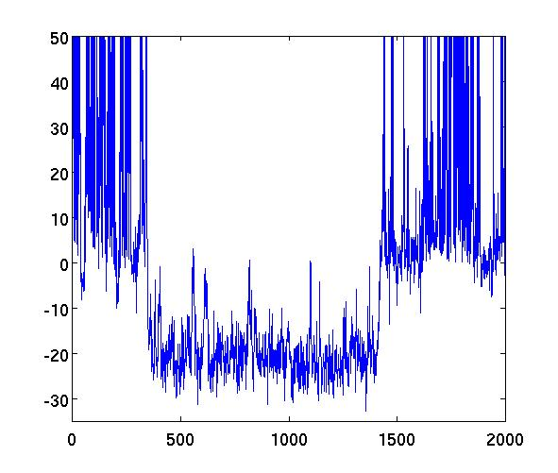
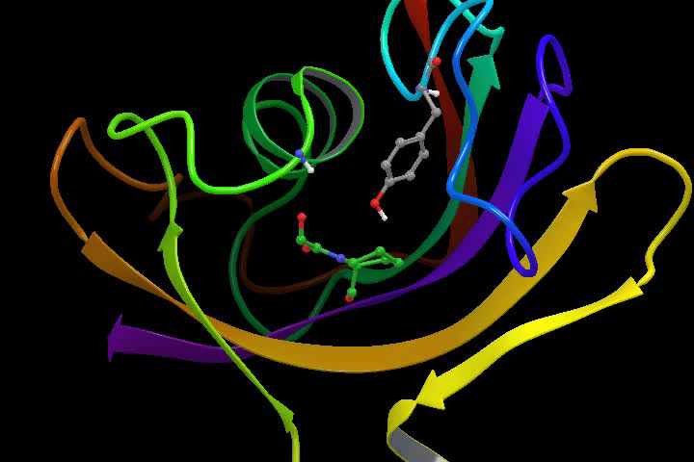
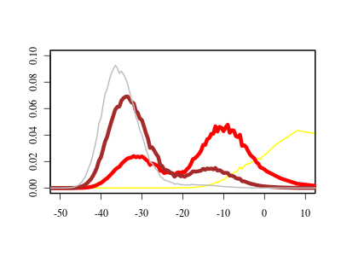
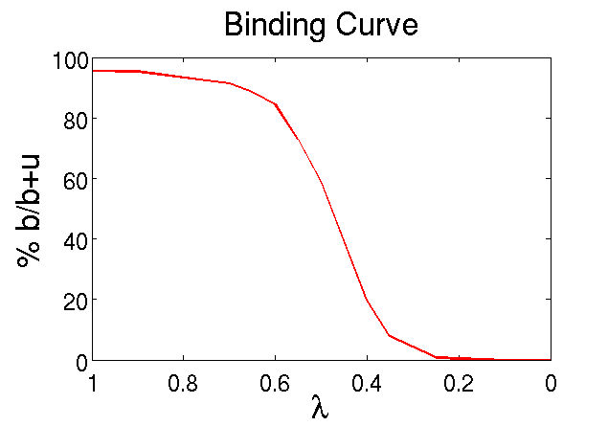
Transition from unbound to bound state is sharp
_{ligand 2 (replica 10)}
_{bound}
_{ΔE [kcal/mol]}
_{unbound}
_{unbound}
_{time [ps]}
Bimodal Binding Energy Distributions
_{λ=0.8}
_{P(ΔE )}
_{λ=0.6}
_{λ=0.5}
_{λ=0.2}
Steep binding curve - pseudo phase transition, like protein folding
Convergence depends on the number of independent transitions between bound and unbound states at the binding curve midpoint
Accelerated conformational sampling techniques required (Yang 2008, Straub 2011)
_{ΔE [kcal/mol]}
_{% Bound}
Notes:
16
16

Slide 17
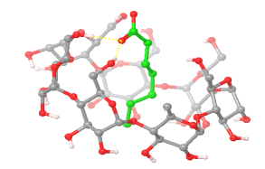
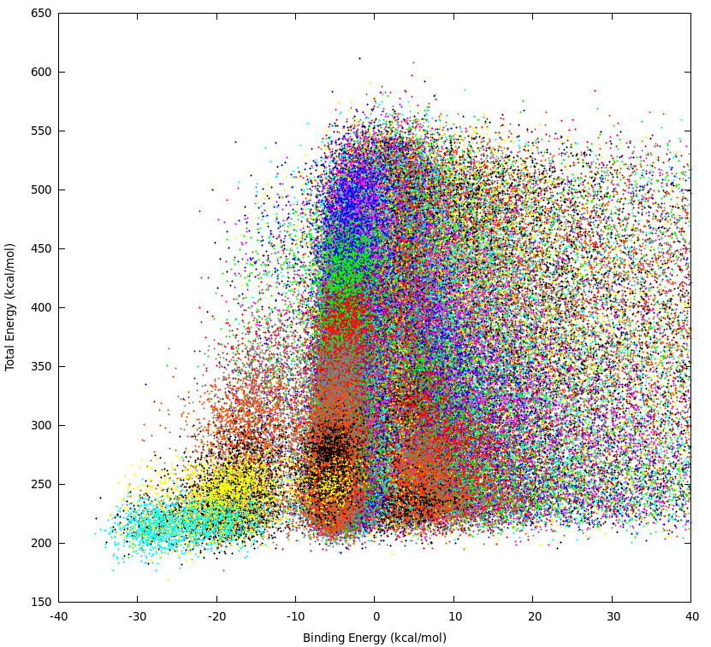
2D Replica Exchange in (λ,T) Space
300K
T
600K
Simultaneous exchanges in temperature and alchemical parameters.
Host-Guest system
unbound
0
24 λ states, 8 temperatures
192 replicas in (λ,T) space
λ
?
Standard synchronous RE approaches are unsuitable for large number of replicas.
Large scale asynchronous RE/distributed computing framework
1μs/day throughput on XSEDE
bound
1
binding energy/total energy distributions
Performance of 2D(T,λ)-RE
 | Number of lambda transitions | Number of lambda transitions per replica
1D-RE 24 replicas | 6 | 0.25
2D-RE 192 replicas | 216 | 1.125
E₀
bound
unbound
u
Temperature is not an optimal choice for enhanced sampling
4 fold improvement in convergence rate

Slide 18
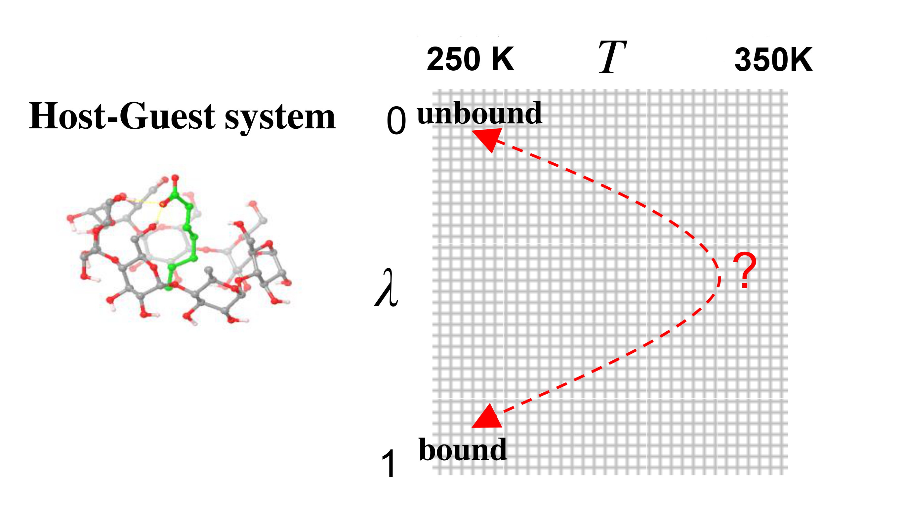

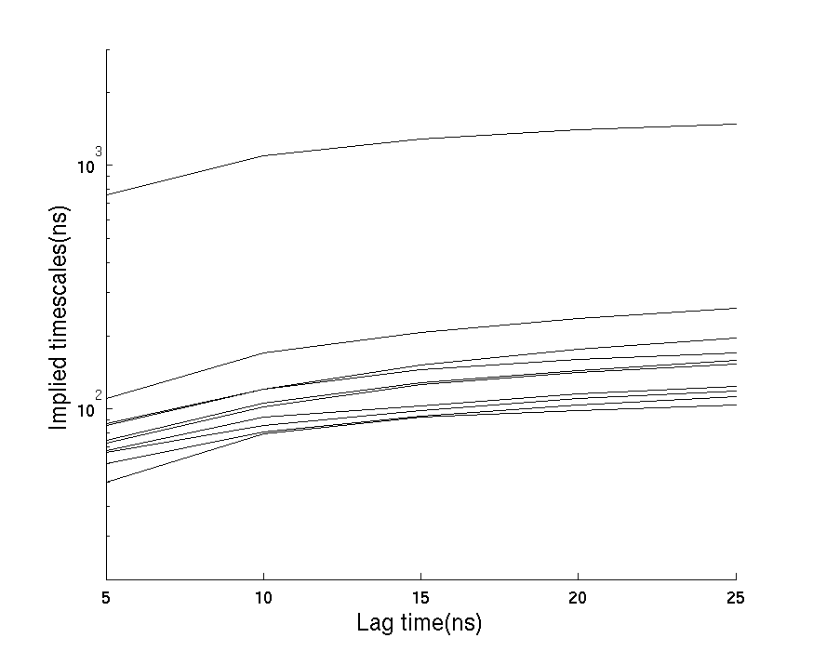
Markov State Models of Replica Exchange
The timescale to equilibrate the Replica Exchange Ensemble is determined by the spectrum of the Transition Matrix
Tij(t) describes the time evolution of the population at j given unit population at state i at time zero.
Tii(t) is the probability of being at i at time t given unit population at state i at time zero.
Markov State Models
Pande, Hummer, Noe, Dill, Brooks, Roux, Schutte, Swope . . .
Spectrum of implied timescales
Markov State Model was used to describe the kinetic network of RE simulations.
Solution to the master equation:

Slide 19
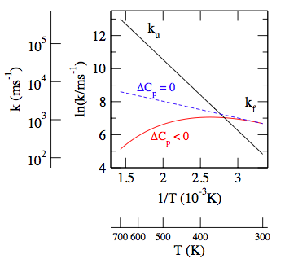
Simulations of Replica Exchange Simulations WZ, MA, EG & RML PNAS (2007)
One replica
Two replicas
N replicas
k_{u}
k_{u2}
F₂
U₂
k_{uN}
F
U
k_{f2}
k_{f}
k_{RE}
k_{RE}
F_{N}
U_{N}
k_{u1}
k_{fN}
F₁
U₁
k_{u} and k_{f}: physical kinetics
k_{RE}: replica exchange “kinetics”
k_{f1}
k_{u2}
F₂U₁
U₂U₁
F₂
U₂
k_{f2}
k_{RE}
F₂F₁
U₂F₁
k_{u1}
F₁
U₁
F₁U₂
U₁U₂
k_{f1}
F₁F₂
U₁F₂
5 replicas: 3840 states
N replicas: 2^{N} N! states
2 replicas: 8 states
Gillespie “simulation of protein folding simulations”
Convergence at low temperature depends on the number of F₁ to U₁ to F₁ “transition events”

Slide 20
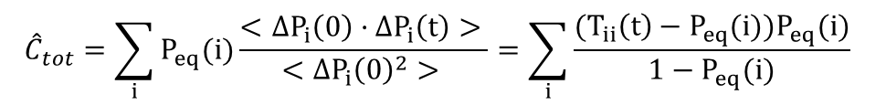
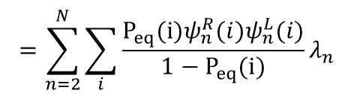
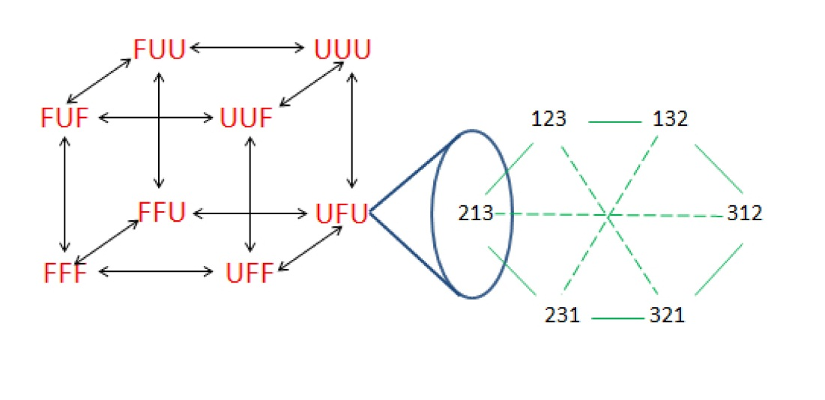
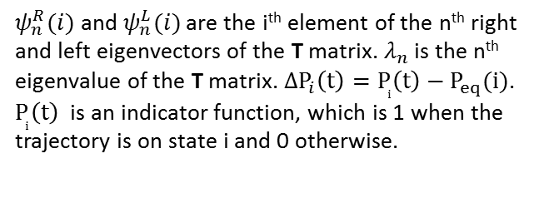
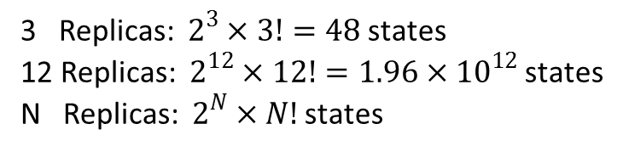
Calculating the Timescale to Equilibrate Replica Exchange
The time to equilibrate the Replica Exchange ensemble can be calculated from the time integral of the population fluctuation correlation function:
An example of RE with 3 replicas:
Levy, Dai, Deng, Makarov, Protein Sci. 2013

Slide 21
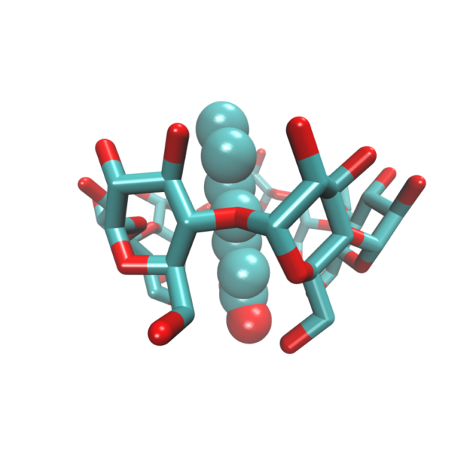
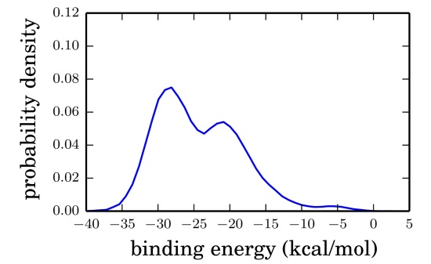
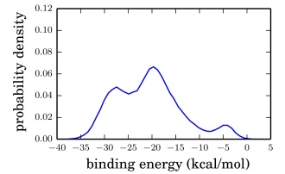
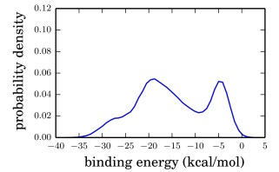
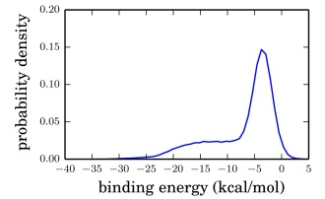
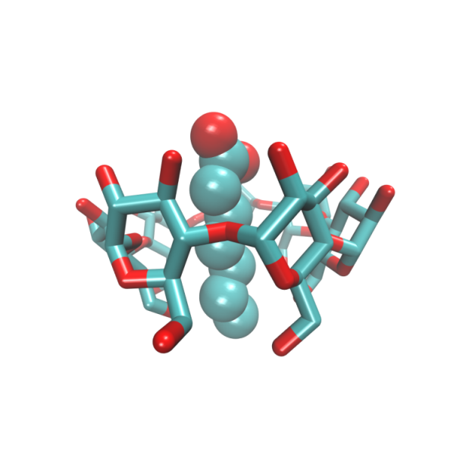
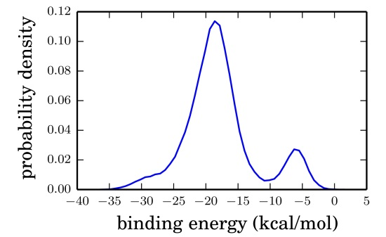
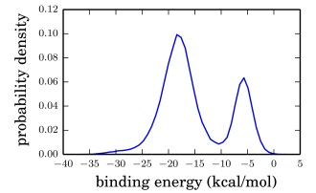



Problems converging Binding Free Energy simulations
Example: Multiple binding modes for the host guest system
Equilibrating the binding modes at large λ is rate limiting, requires Replica Exchange
β-cyclodextrins
secondary alcohols
λ=1.00
BF simulation: No 180 degree flip
λ=0.95
λ=0.90
λ=0.80
State I
Heptanoate
State II
Primary alcohols
RE simulation:
Analysis tool:
Simulations of binding free energy simulations (SOS)

Slide 22





Evolving Simulations of Replica Exchange Simulations (ESOS)
Construct MSMs of RE using the data from parallel simulations. We construct the transition matrix for the binding energy histograms at each Hamiltonian state
We can study different RE proposal schemes - versions of Gibbs sampling
The SOS evolves to satisfy the RE Metropolis criteria

Slide 23




Calculating the Time to Equilibrate BEDAM
A Markov State Model was used to estimate the time to equilibrate the binding of Heptanoate to β-cyclodextran. We only considered the orientation of Heptanoate at four largest λ states. Therefore the complete state space was projected onto 16 physical states.
The total relaxation time is dominated by the slowest implied timescale. The slowest implied
timescale corresponds to the reorientation of Heptanoate at λ=1.0.

Slide 24


Efficiency of Different Proposal Schemes: Gibbs Sampling vs. Nearest Neighbor
Three RE proposal schemes were implemented in SOS:
Nearest Neighbor Exchange (NNE)
Independent and sequential Gibbs Sampling: GS1 and GS2
The nearest neighbor exchange method is the fastest for this test, but there is no general rule
All three proposal schemes converged to the same limit when the number of exchange
attempts / ps was larger than 50
When the exchange attempts / ps is low, the proposal scheme matters a lot more
J. D. Chodera and M. R. Shirts, J. Chem. Phys. 135, 194110 (2011).

Slide 25
_{Conclusions}
BEDAM: binding affinities from probability distributions of binding energies at many λ using parallel Hamiltonian Replica Exchange with implicit solvent
Full account of entropic effects and reorganization free energies of the ligand and receptor
Converging binding free energy simulations is still challenging; we are pursuing approaches based on multi-dimensional Replica Exchange and stochastic alternatives to solving the WHAM equations
Gallicchio, Levy; “Advances in all atom sampling methods for modeling protein-ligand binding affinities”. Curr. Op. Struct, Biol. 21, 161-166 (2011)
Zhang, Gallicchio, Dai, He, Levy; “Replica exchange sampling of free energies: proposal schemes, reweighting techniques, and Markov State Models”, to be submitted
Gallicchio, E., M. Lapelosa, and R.M.Levy. JCTC., 6, 2961-2977 (2010)
Gallicchio, E., and R.M. Levy, Adv. in Protein Chemistry & Structural Biology, 85, 27-80 (2011)

